Slide 1

Title: Introduction to Our Website
Star Brand
EAT RIGHT FOOD
Eat Healthy, it is good for our health.
(LOGO)

Slide 2
Meet the Team
[NAME : Atta muhammad (Leader)]
[Name : Aniqa Tauseef(Member)]
[Name : Hassan Ullah(member)]

Slide 3
Team Member Contributions :-
Our Contributions to the Project:
Atta Muhammad: Developed 85% of the website, Create Developer Guide And User Guide.
Hassan Ullah: Developed 15% of the website, Create Screen Shot And Source Code With Comments.
Aniqa Tauseef: Prepared essential documentation And Logo Of Our Website

Slide 4
Problem Solving
"We established this website with a singular mission in mind - to offer our customers access to the finest products from the comfort of their own homes. Our platform has been meticulously designed to bring the best of the best directly to your fingertips. What sets us apart is our commitment to delivering a seamless and hassle-free experience. Our website is not just easy to navigate; it's also responsive, adapting effortlessly to various devices, ensuring that you can explore our offerings with ease. With a strong emphasis on speed and user-friendliness, our website is designed to make your online shopping experience swift and enjoyable."

Slide 5
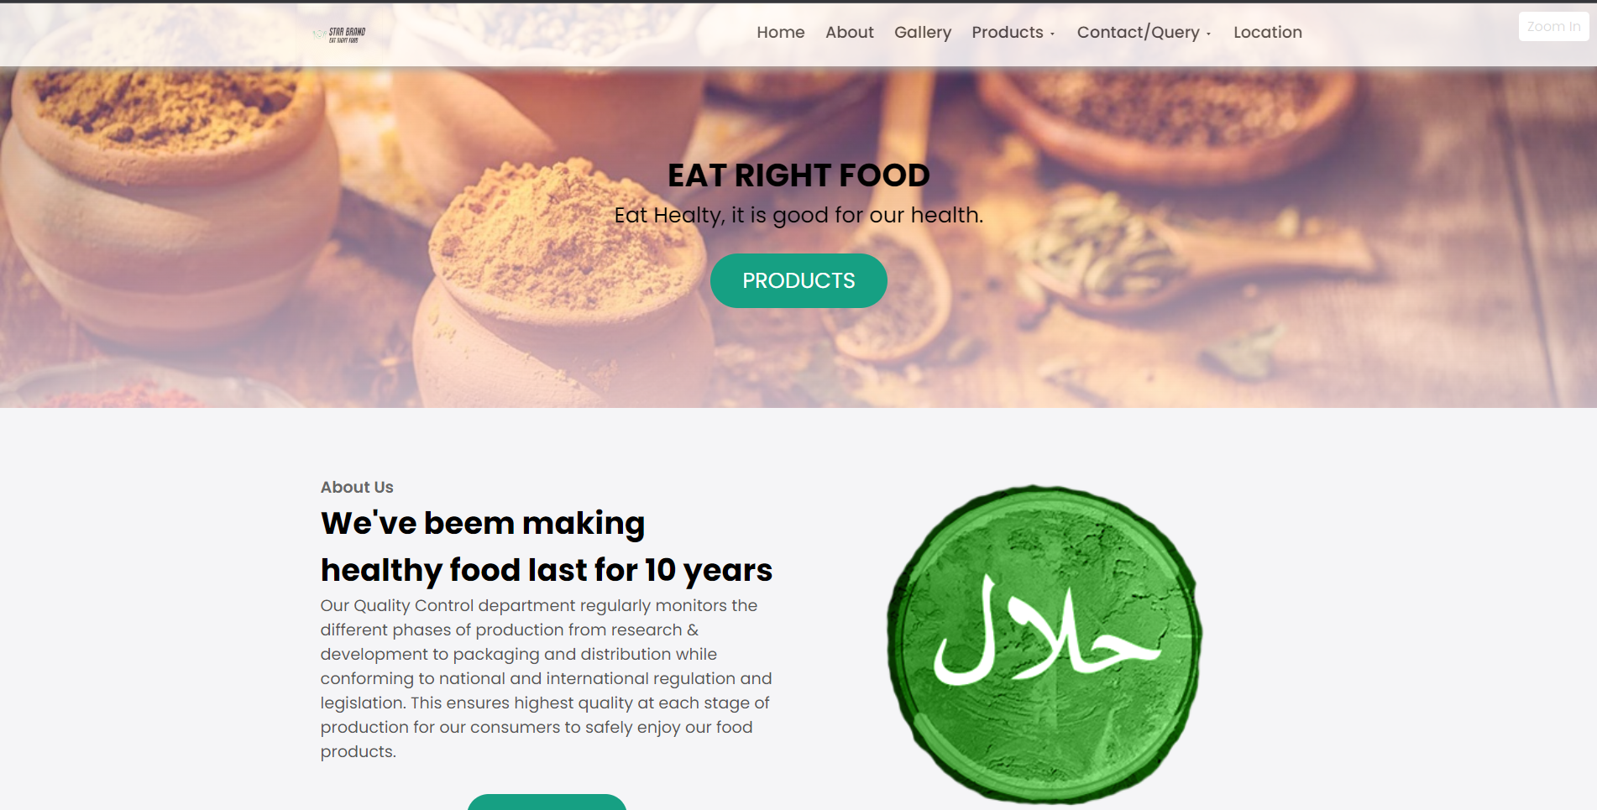
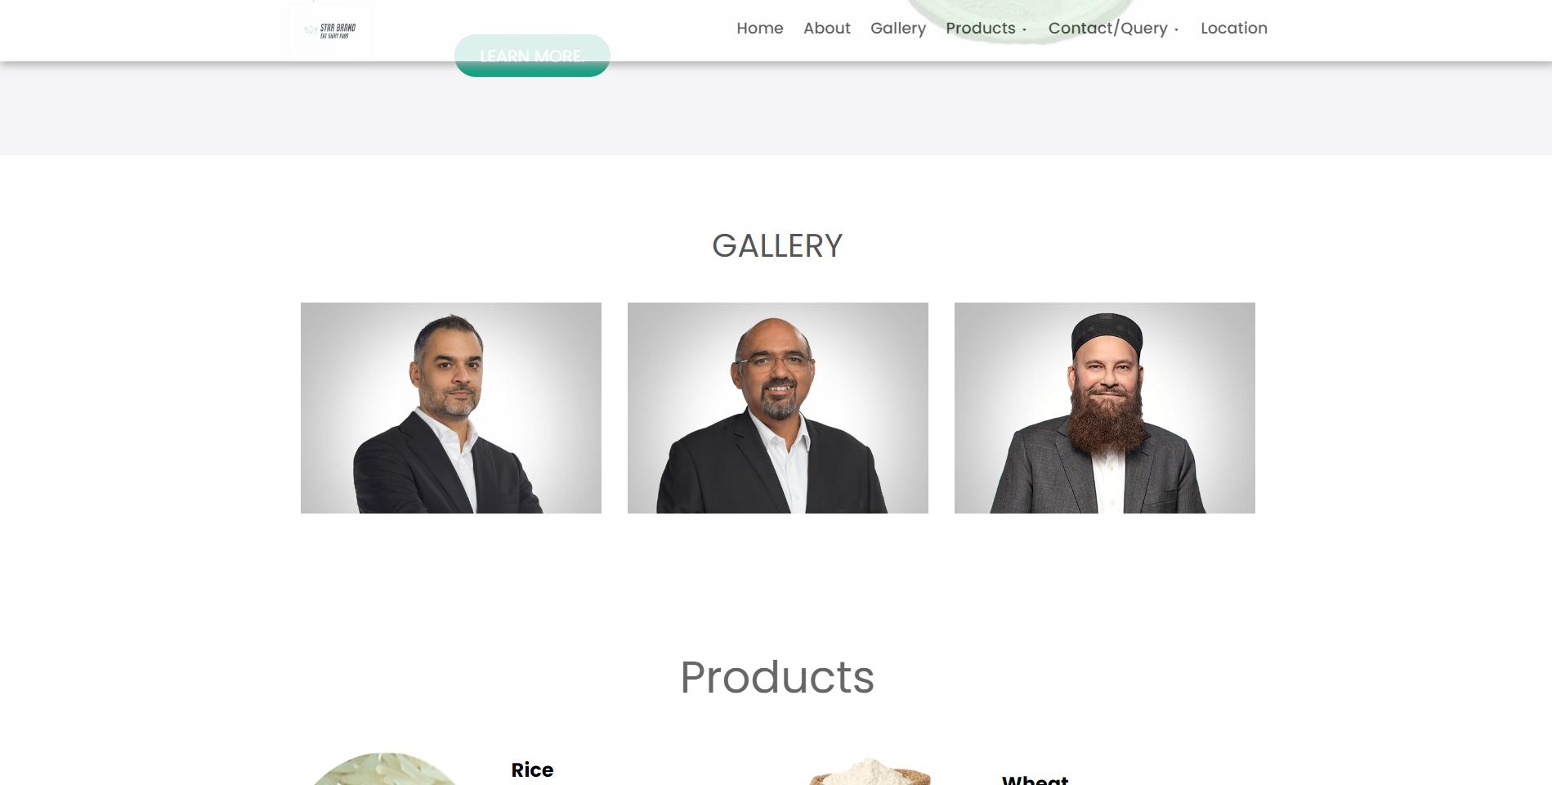
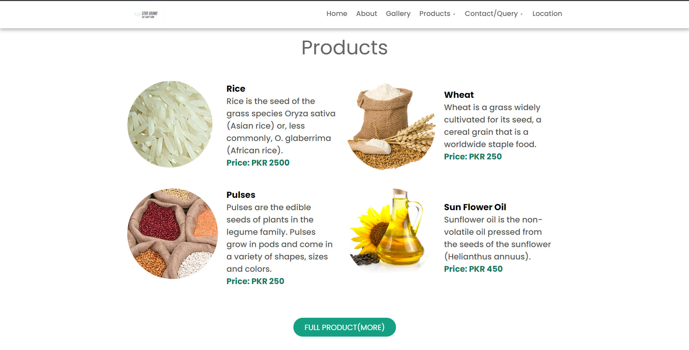
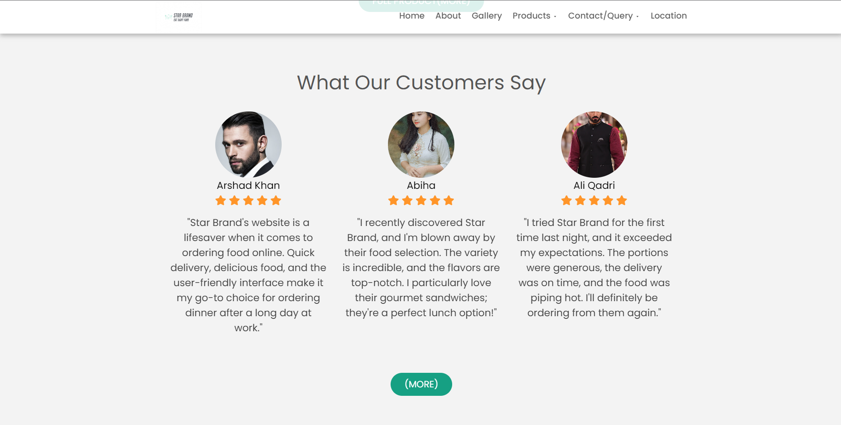
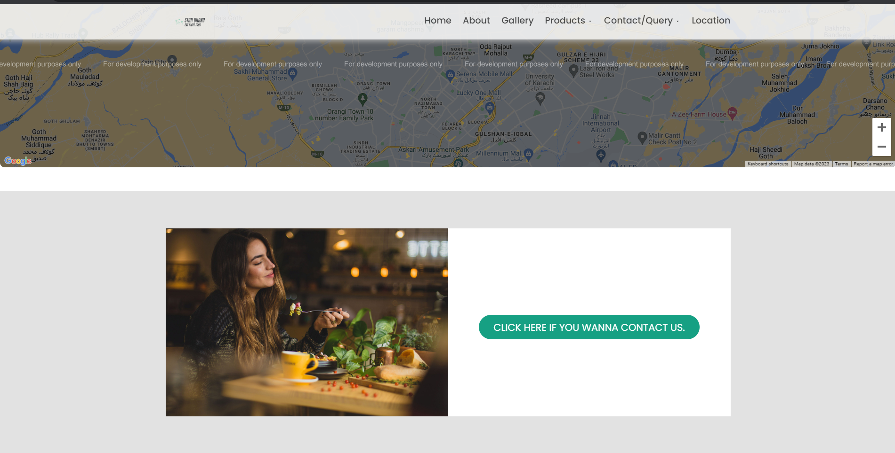
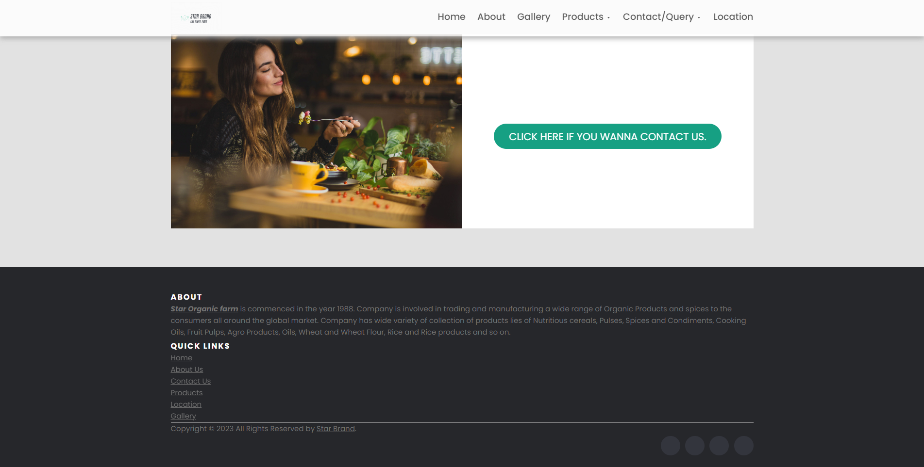
Screenshot Gallery
HOME PAGE

Slide 6
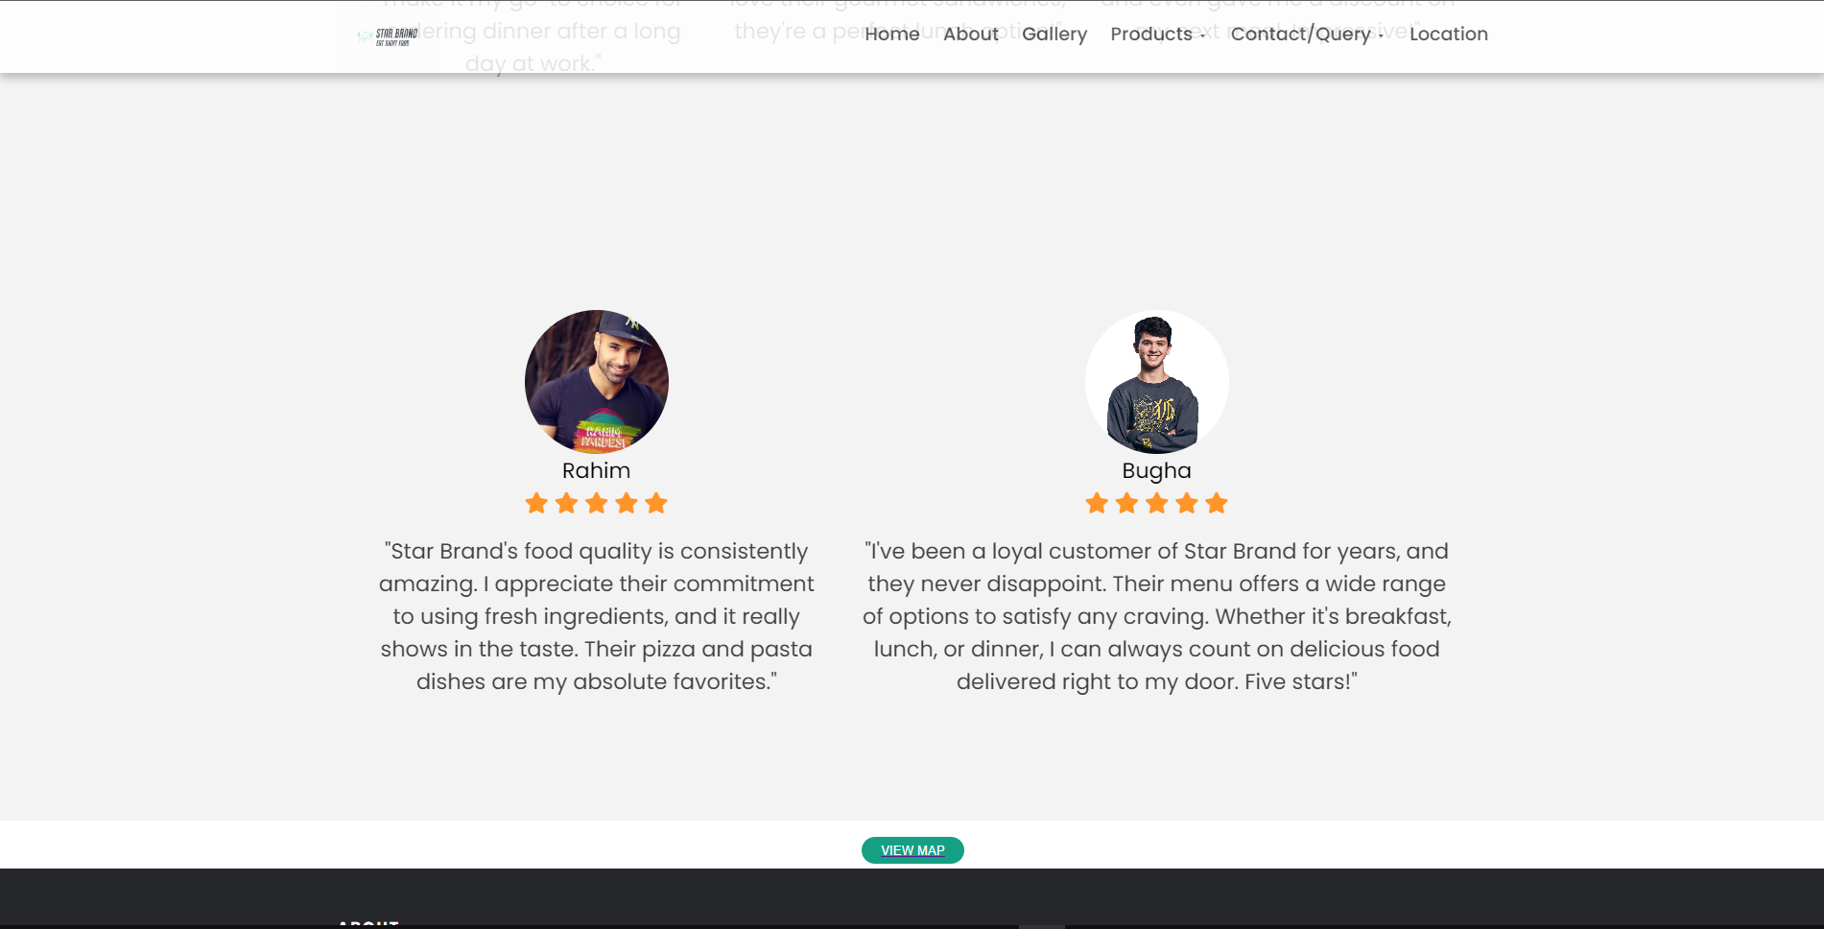
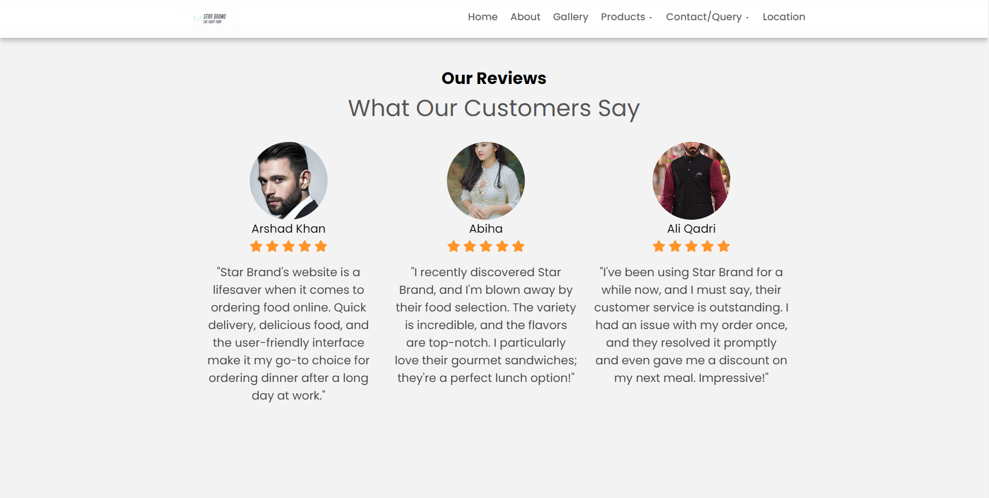
Testimonials
OUR REVIEWS

Slide 7
Thank You For Watching My Presentation
I Hope You Like It

